Slide 1
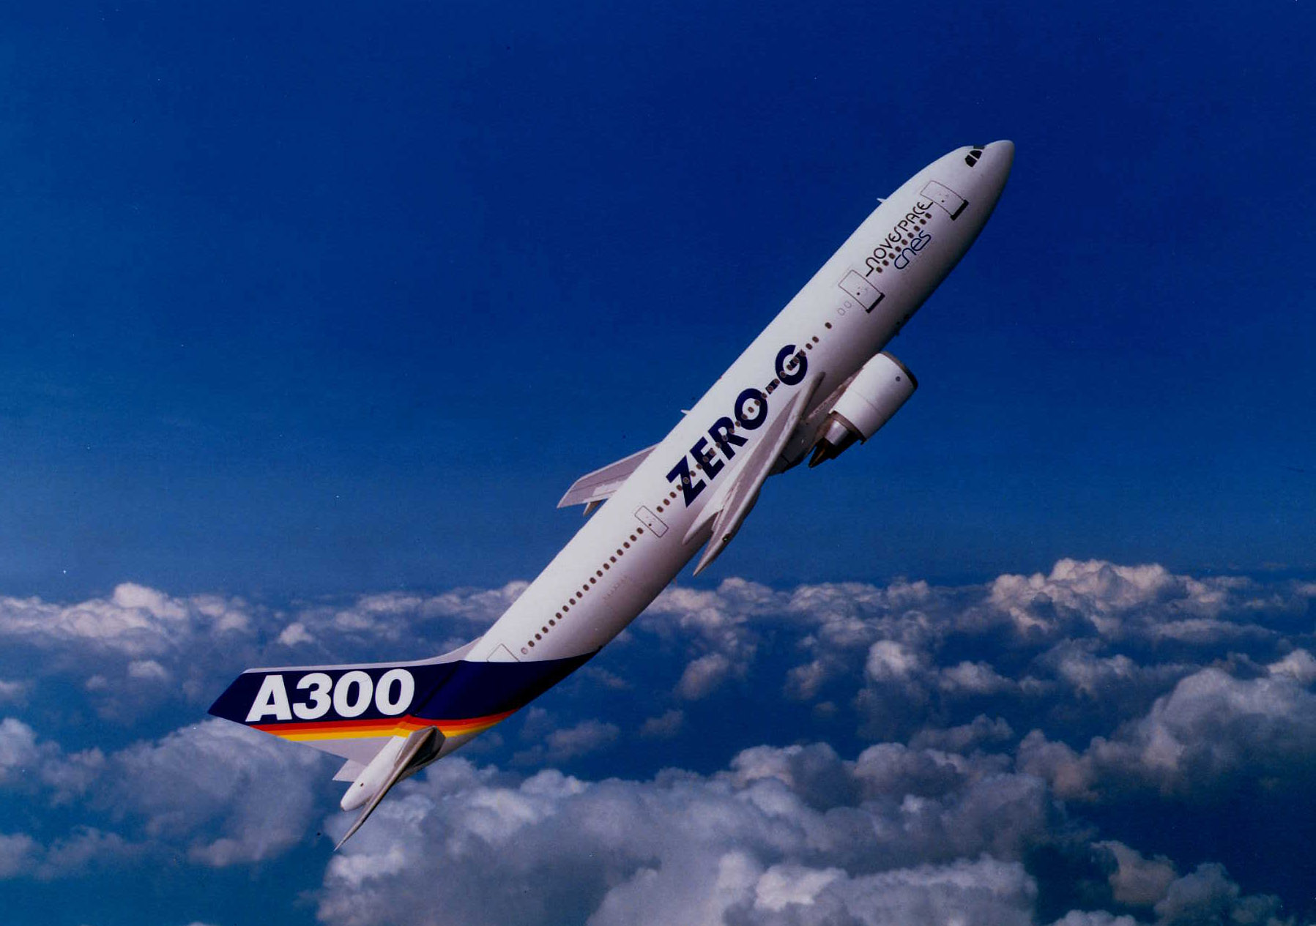
Results of the Parabolic Flights of 2013 & 2014 A
high temperature
high chemical reactivity
R. K. Wunderlich, H.-J. Fecht and the ThermoLab Project
University of Ulm
Institute for Micro and Nanomaterials

Slide 2
Alloys Processed
1.
Ni-based, MTU Aeroengines

Slide 4
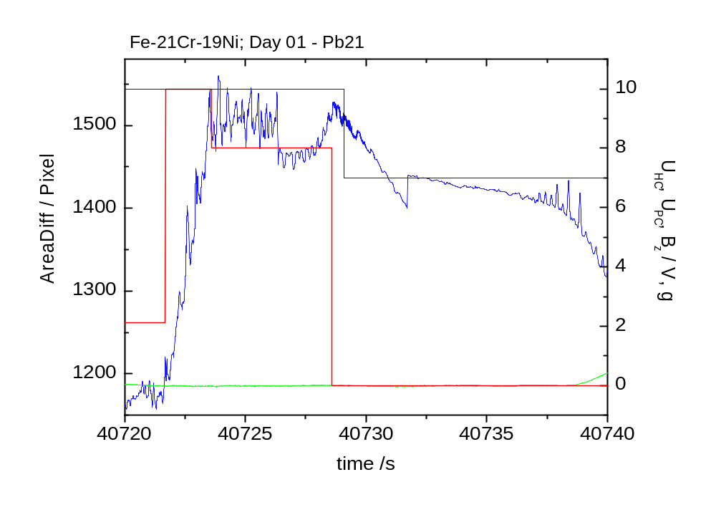
Fe-21Cr-19Ni TEMPUS MSL-EML Batch1
Processing in PF-2013

Slide 5
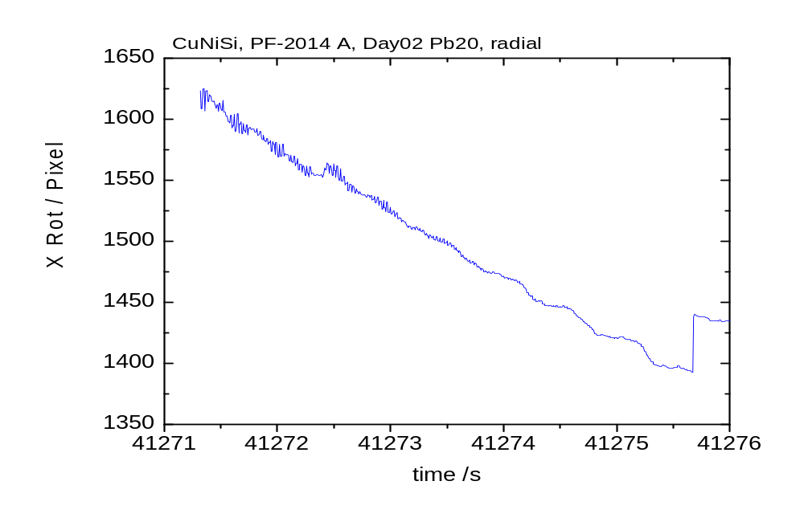
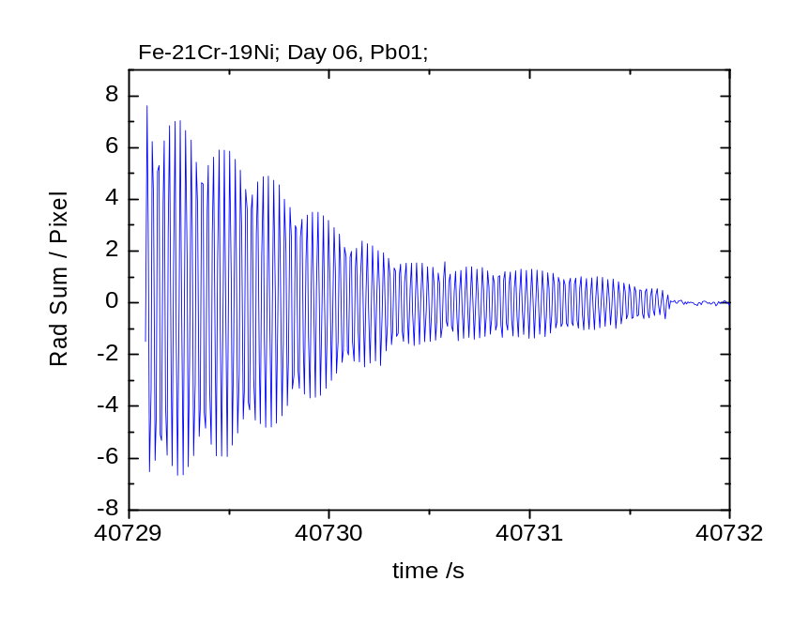
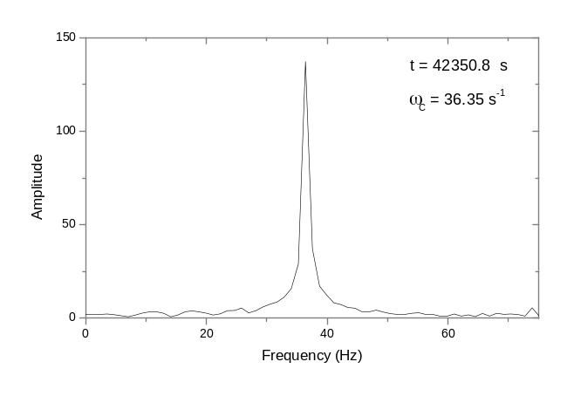
Data Quality Day01 – no pulse excitation

Slide 6
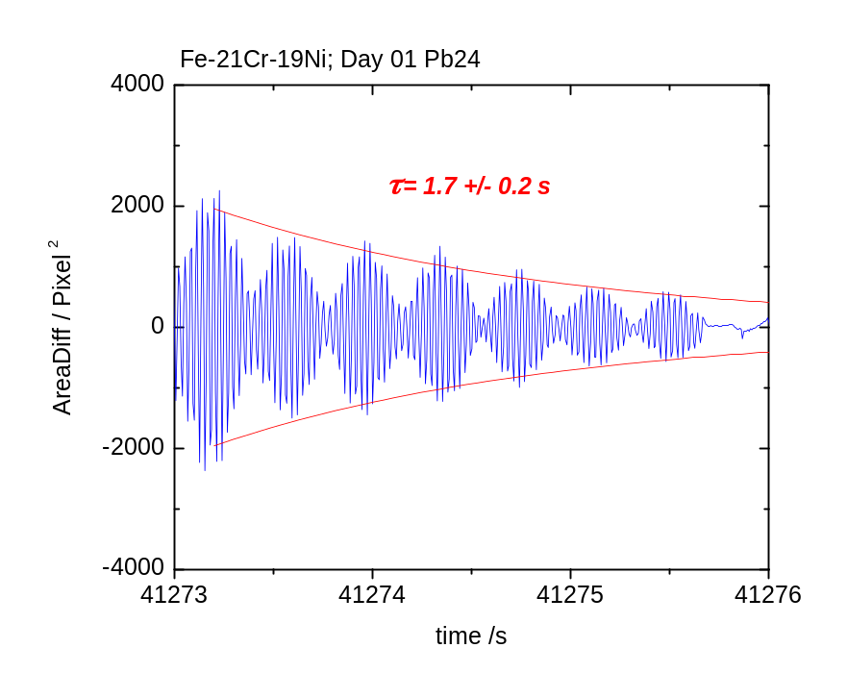
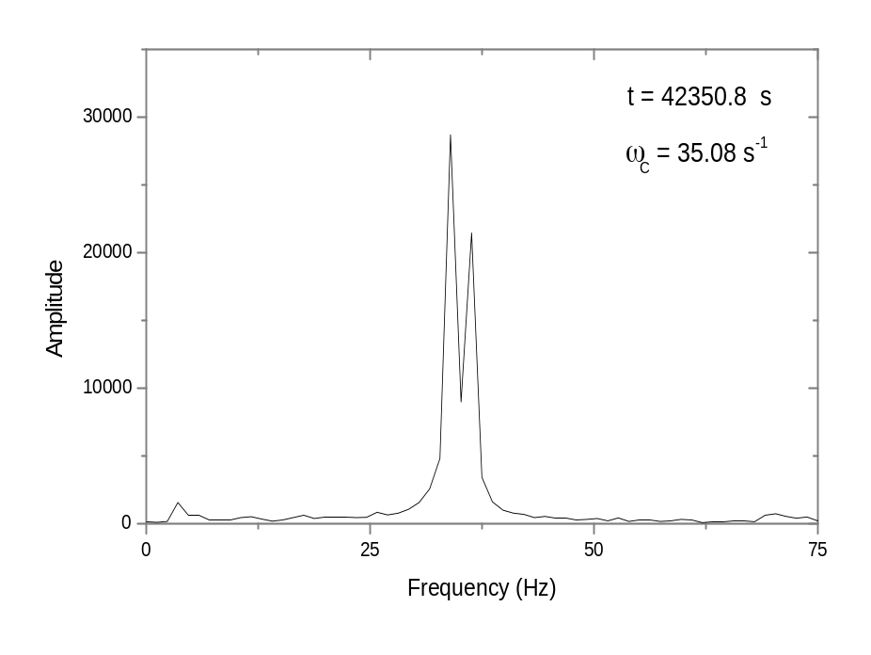

Slide 7
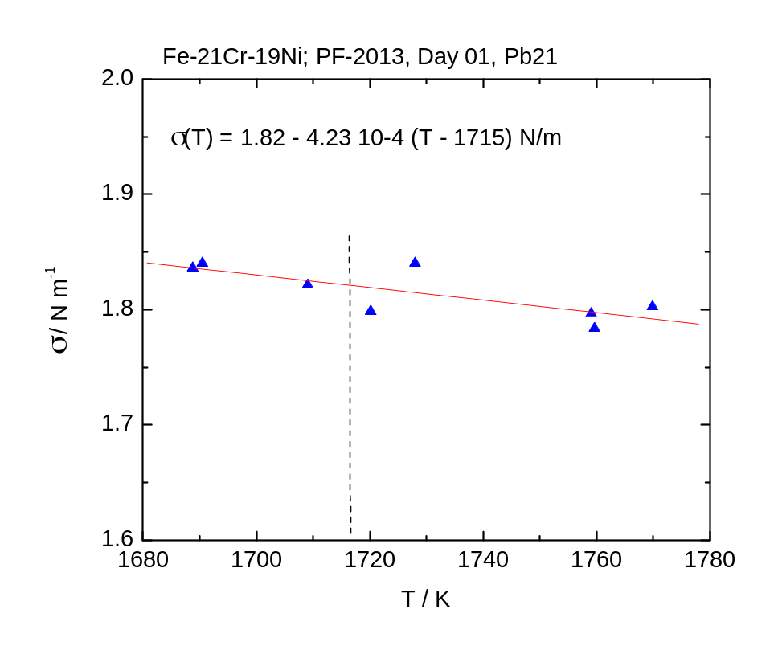
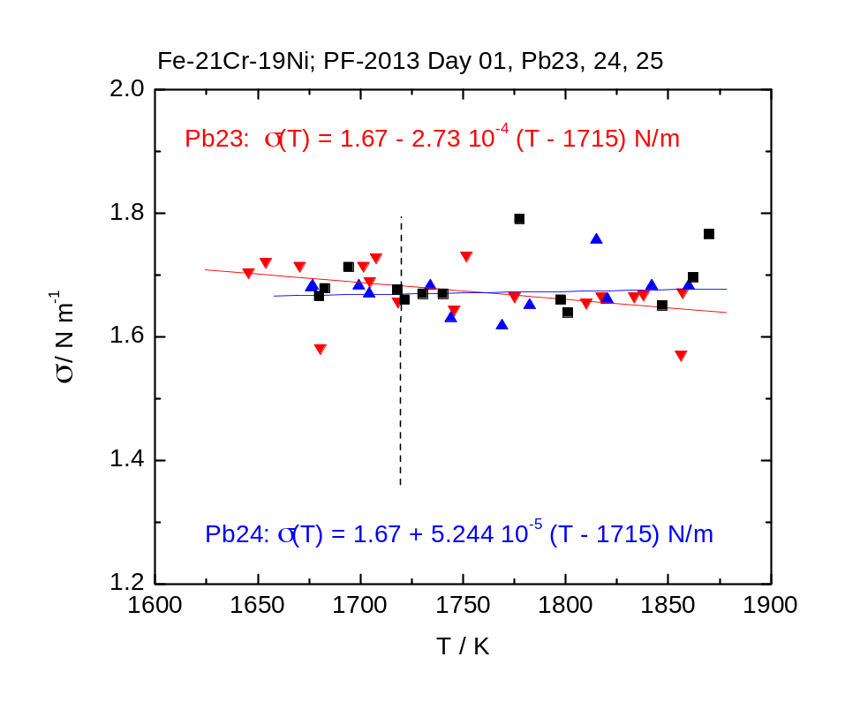
1st parabola with sample

Slide 8
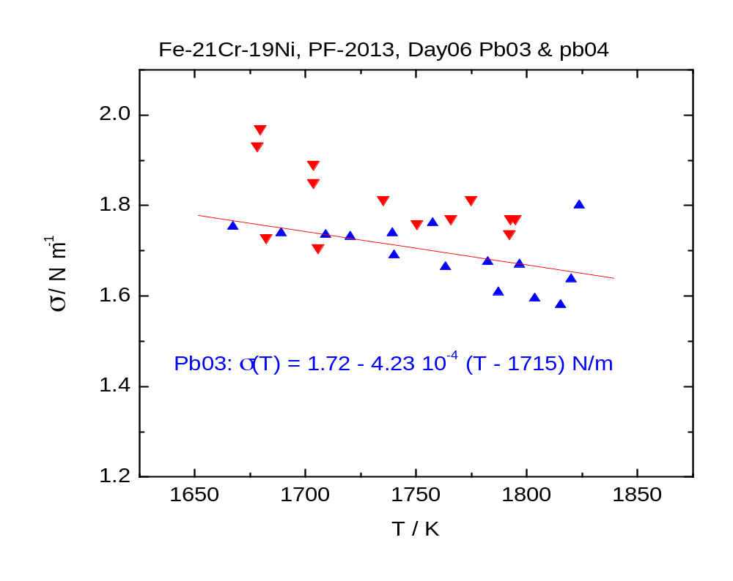

Slide 9
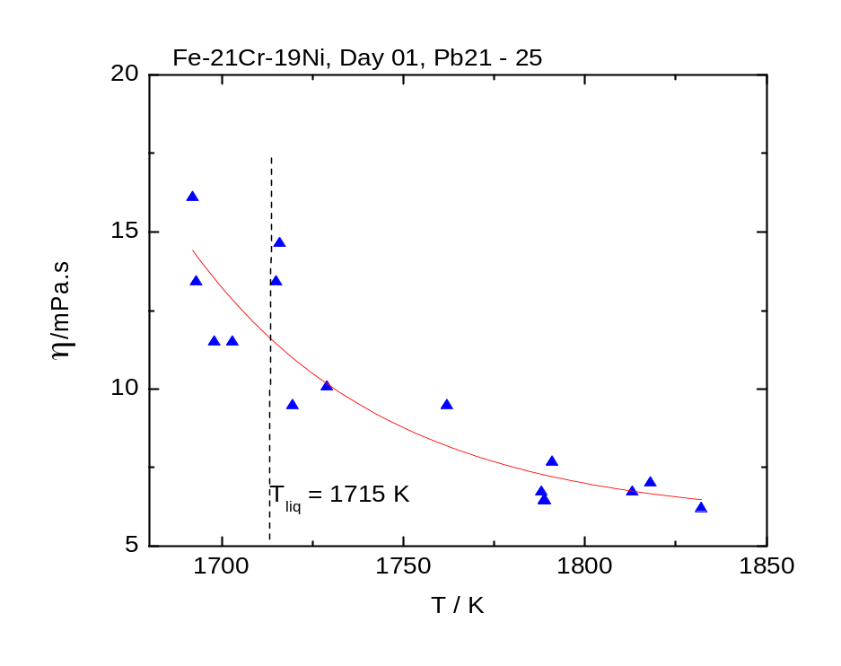
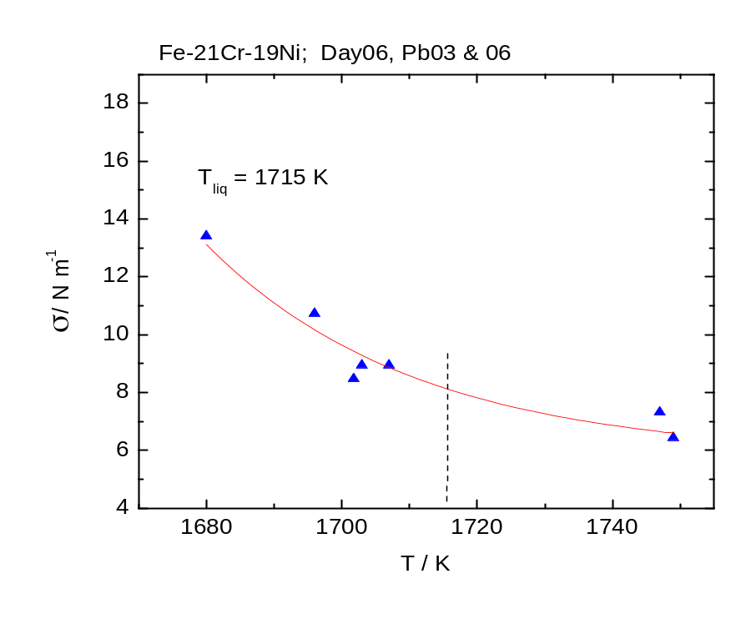
η(T_{liq}) = 11.6 mPa.s
η(T_{liq}) = 8.1 mPa.s

Slide 10
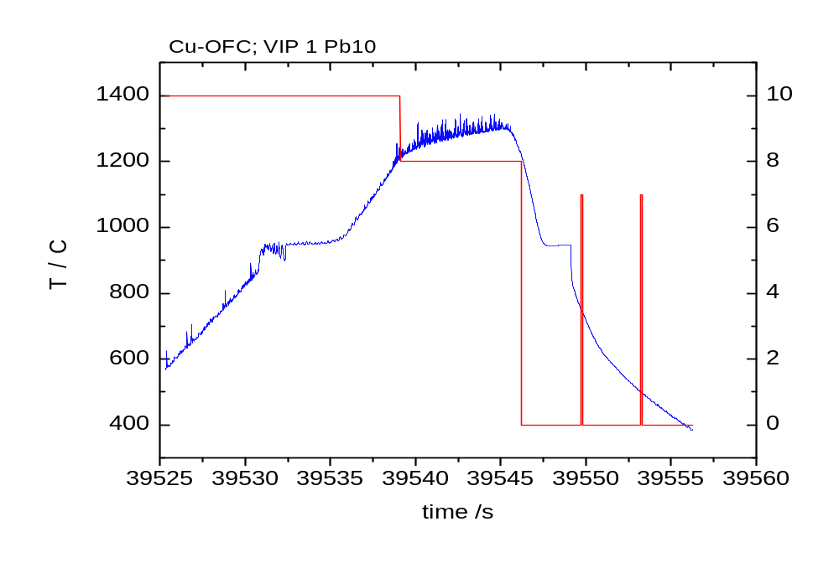
Cu-OFE Wieland Metallwerke
Three parabolas performed, two could be evaluated
first parabola with Cu - OFE

Slide 11
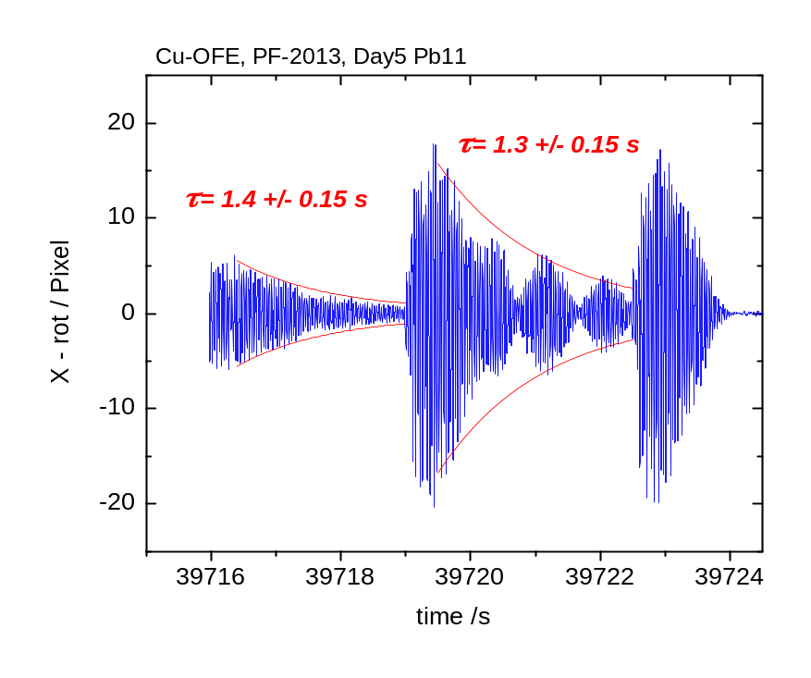
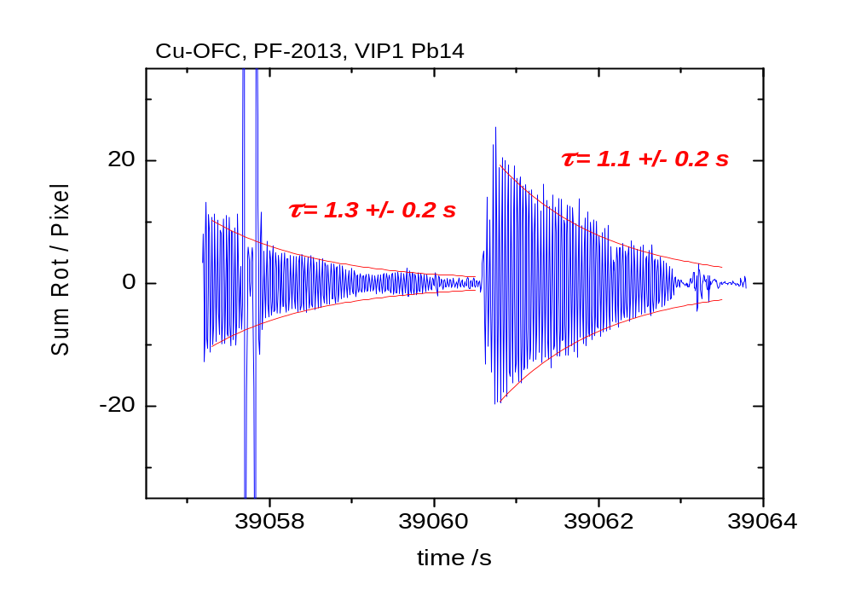
Cu-OFE Wieland Metallwerke – Quality of Data

Slide 12
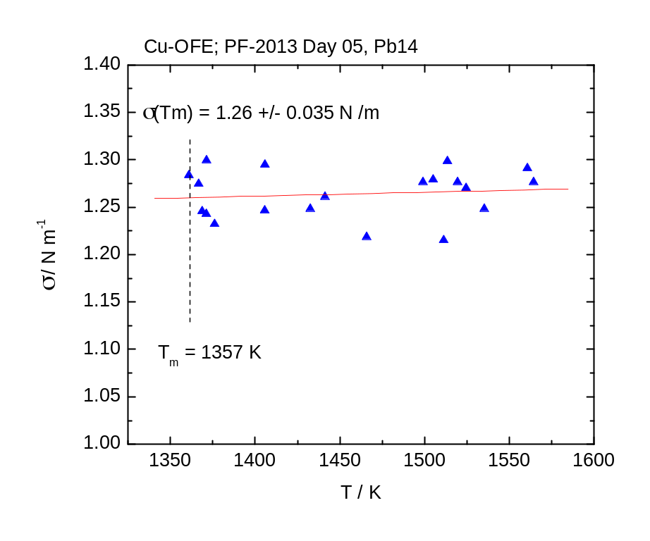
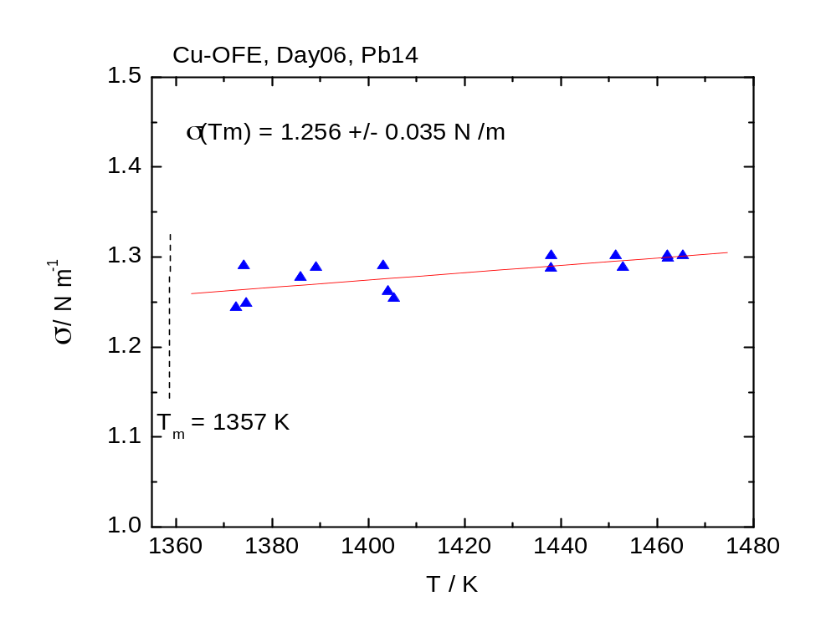
two parabolas for evaluation

Slide 13
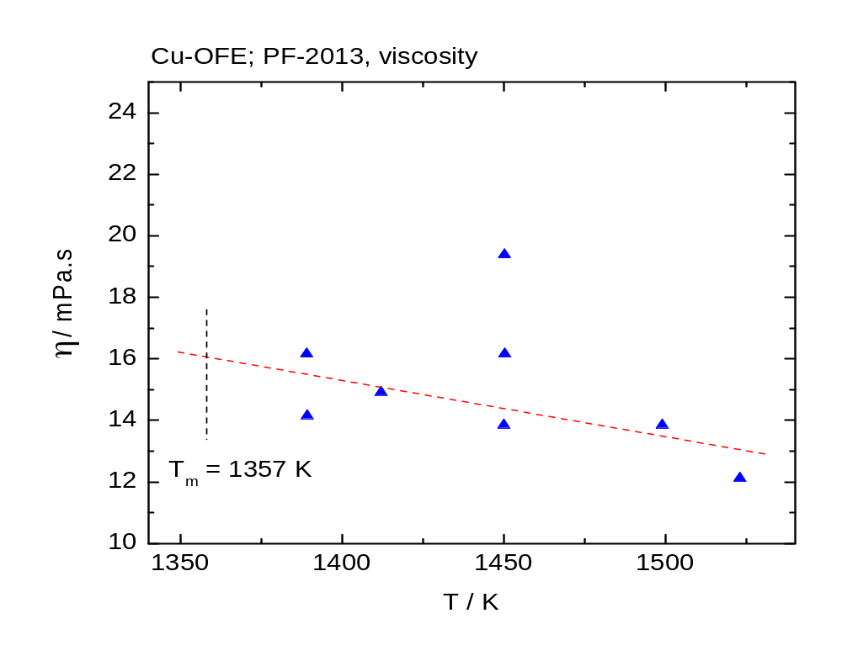
Cu-OFE Wieland Metallwerke – Result Viscosity
results from two parabolas

Slide 14
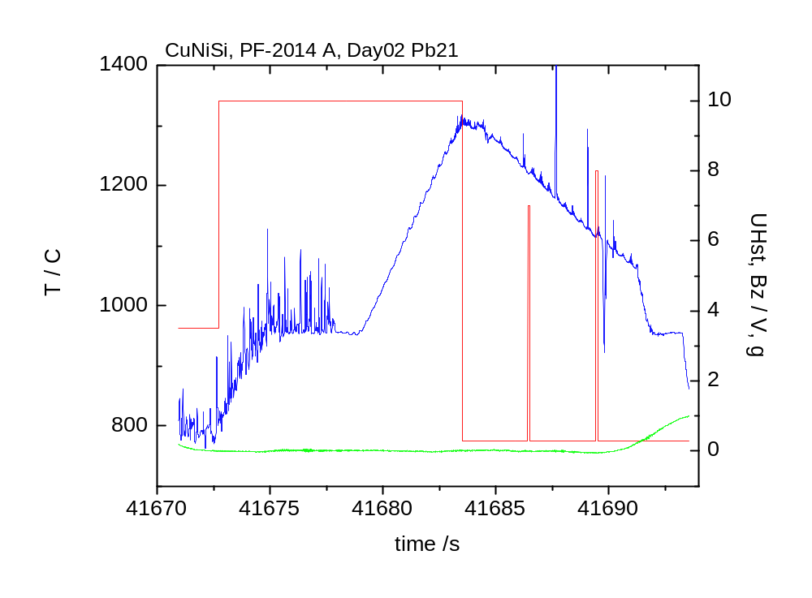
Cu-Ni-Si Wieland Metallwerke PF2014 A

Slide 15
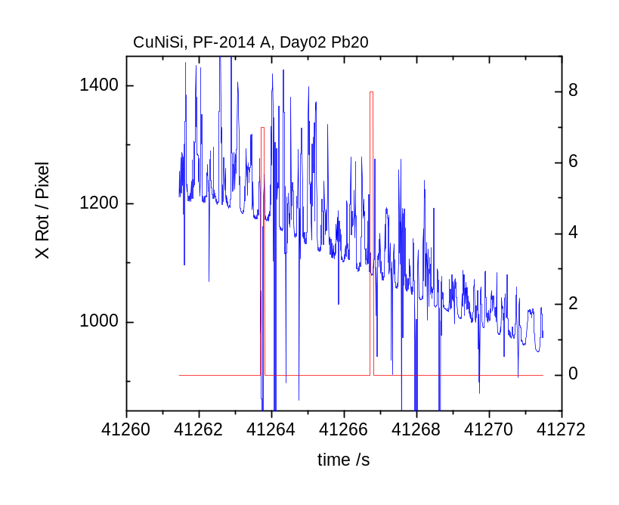
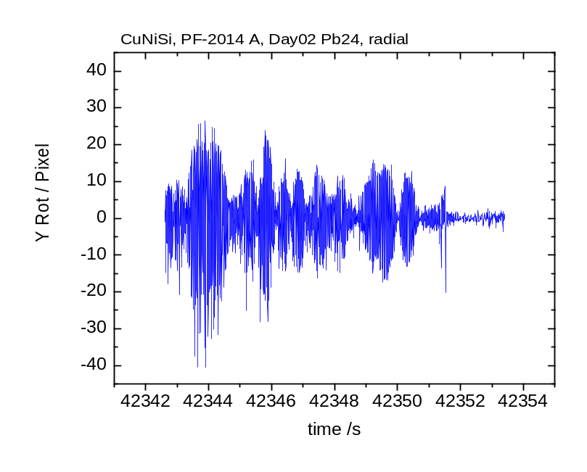
Cu-Ni-Si Data Quality
axial camera data could not be used – camera/cup alignment
radial camera distorted

Slide 16
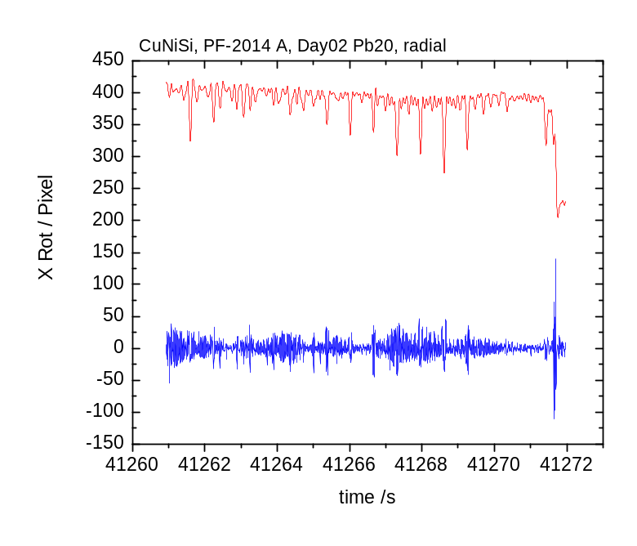

Slide 17
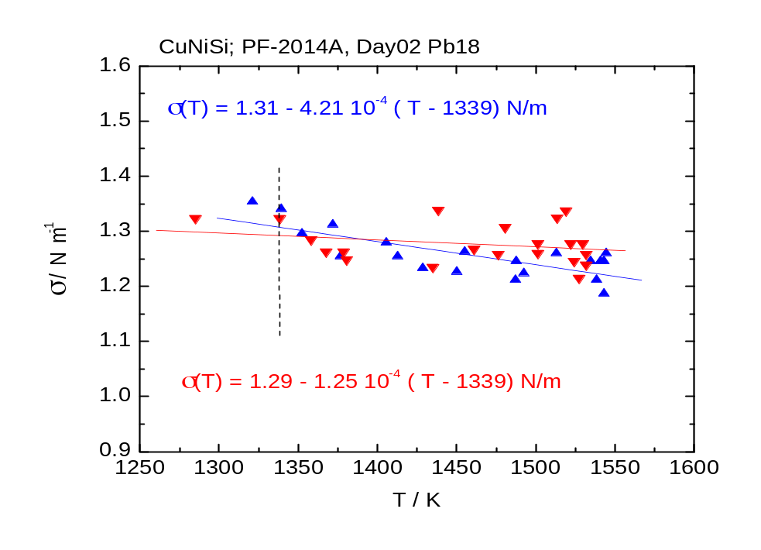
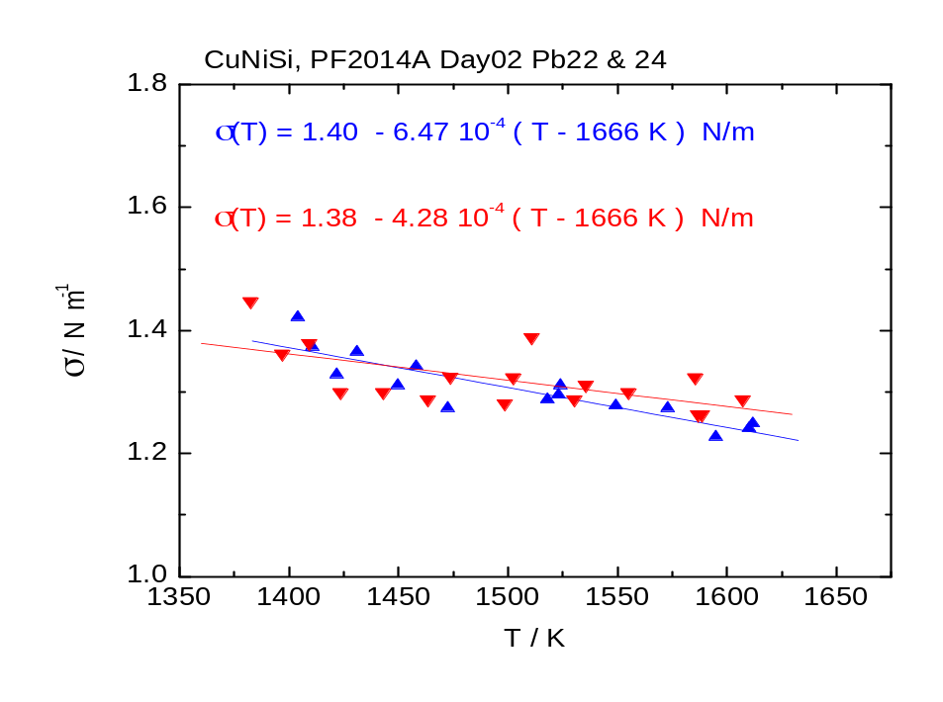
CuNiSi Results Surface Tension
Pb18: σ(T) = 1.31 – 4.21 10⁻⁴ ( T – 1339 K ) N/m
Pb19: σ(T) = 1.29 – 1.25 10⁻⁴ ( T – 1339 K ) N/m
Pb20: s(T) = 1.35 – 3.34 10⁻⁴ ( T – 1339 K ) N/m

Slide 18
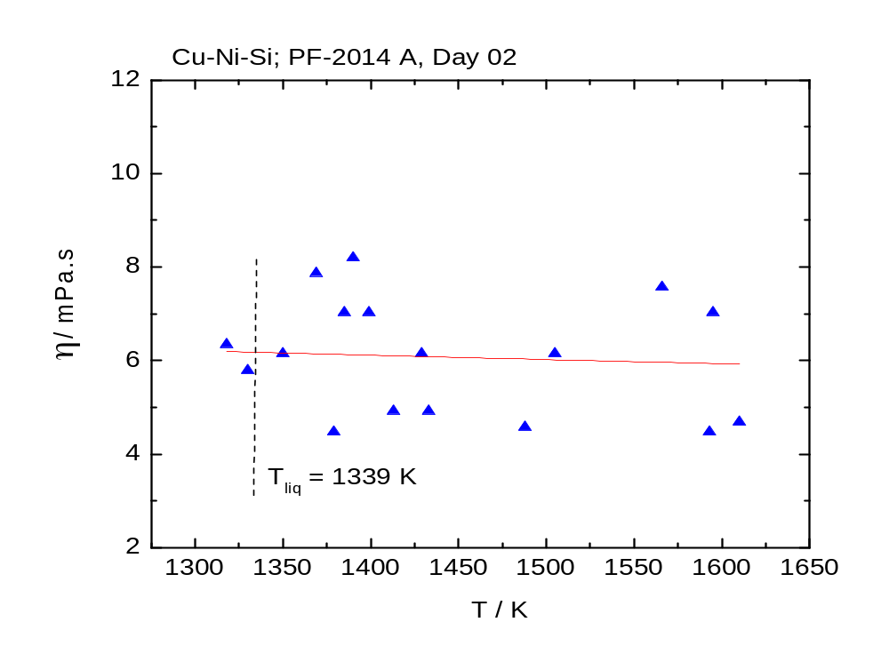
Cu-Ni-Si Result Viscosity all Parabolas

Slide 21
End of Presentation
Thank you for Your Attention

